Slide 1
Build and Deploy IoT Honeypots with Python and Docker
pyistanbul - Birkan Kolcu - 07.07.2020

Slide 2
About Me
Graduated from University of Arizona (UoA) with Ms. Sc. Degree in ECE.
Worked as grad. research assistant in UoA for about 2 years. Reserch in Cybersecurity, IoT and data visualization.
Graduated from Ozyegin University with Computer Science Bachelor Degree.
Personal projects/internships/research experience in embedded Linux systems, cloud, IoT, robotics, High Performance Computing.
Co-founded dusuncembu.com for helping businesses collect customer feedback in physical places.
Github: https://github.com/ResearcherOne

Slide 3
Overview
Building a Simple Honeypot with Python
Dockerizing the Honeypot written in Python
Deployment of Dockerized Honeypot on a Raspberry Pi
Honeypot in action!

Slide 4
1- Building a Simple Honeypot with Python
What is honeypot?
Where did honeypot came from?
Real world honeypot examples.
Building honeypot with Python.

Slide 5
1- Building a Simple Honeypot with Python
What is honeypot?
Imitation of real world vulnerable system.
Where did honeypot came from?
Real world honeypot examples.
Building honeypot with Python.

Slide 6
1- Building a Simple Honeypot with Python
What is honeypot?
Imitation of real world vulnerable system.
Production vs research.
Where did honeypot came from?
Real world honeypot examples.
Building honeypot with Python.

Slide 7
1- Building a Simple Honeypot with Python
What is honeypot?
Imitation of real world vulnerable system.
Production vs research.
Where did honeypot came from?
1989, Clifford Stoll, The Cuckoo's Egg
Real world honeypot examples.
Building honeypot with Python.

Slide 8

1- Building a Simple Honeypot with Python
What is honeypot?
Imitation of real world vulnerable system.
Production vs research.
Where did honeypot came from?
1989, Clifford Stoll, The Cuckoo's Egg
Real world honeypot examples.
Building honeypot with Python.
The Cuckoo’s Egg

Slide 9
1- Building a Simple Honeypot with Python
What is honeypot?
Imitation of real world vulnerable system.
Production vs research.
Where did honeypot came from?
1989, Clifford Stoll, The Cuckoo's Egg
Real world honeypot examples.
sshesame, Mert Sarıca “Tuzak Sistem ile Hacker Avı”
Building honeypot with Python.
The Cuckoo’s Egg

Slide 10
1- Building a Simple Honeypot with Python
What is honeypot?
Imitation of real world vulnerable system.
Production vs research.
Where did honeypot came from?
1989, Clifford Stoll, The Cuckoo's Egg
Real world honeypot examples.
sshesame, Mert Sarıca “Tuzak Sistem ile Hacker Avı”
Building honeypot with Python.
The Cuckoo’s Egg

Slide 11
1.4- Building honeypot with Python
Our Goal
Imitate ftp (file transfer protocol).

Slide 12
1.4- Building honeypot with Python
Our Goal
Imitate ftp (file transfer protocol).
Trigger alarm on login.

Slide 13
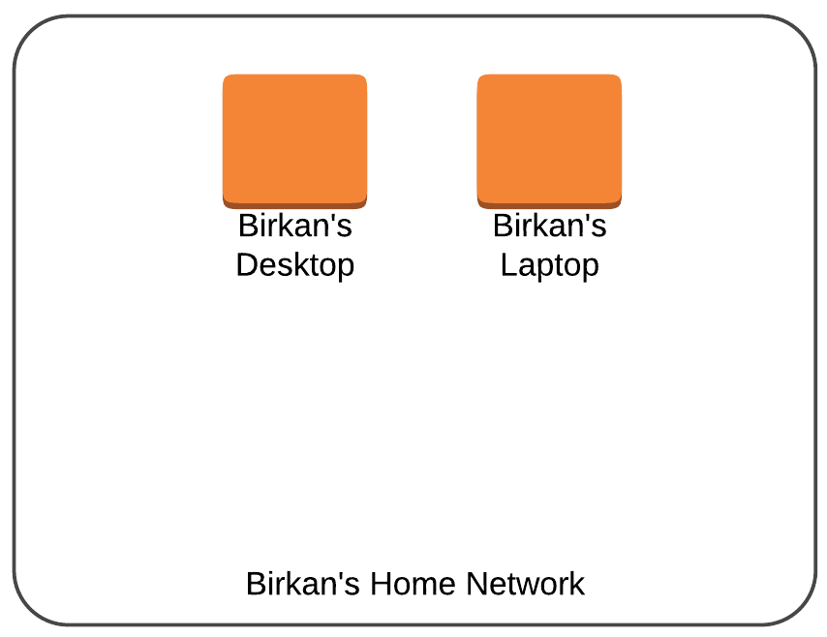
1.4- Building honeypot with Python
Our Goal
Imitate ftp (file transfer protocol).
Trigger alarm on login.

Slide 14
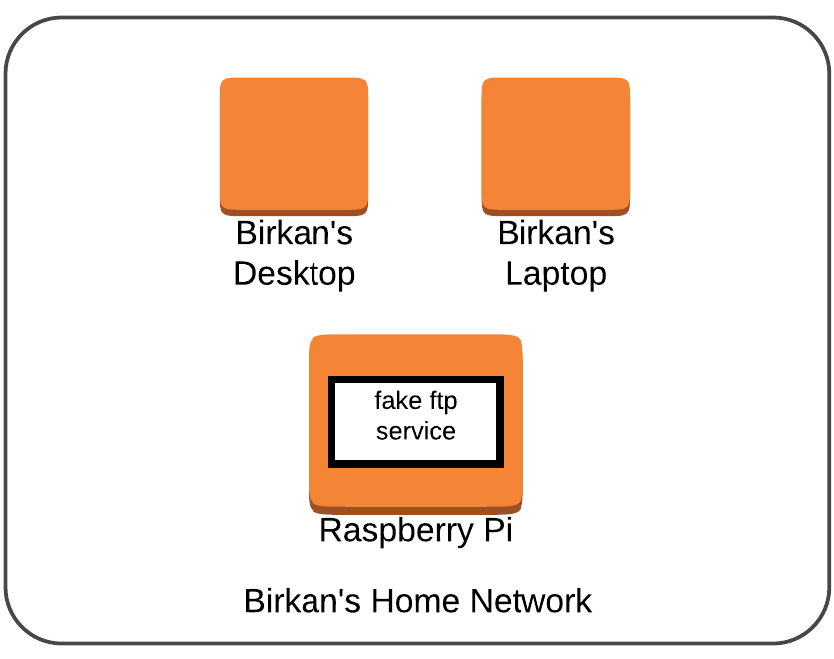
1.4- Building honeypot with Python
Our Goal
Imitate ftp (file transfer protocol).
Trigger alarm on login.

Slide 15
1.4- Building honeypot with Python
Our Goal
Imitate ftp (file transfer protocol).
Trigger alarm on login.
Let’s check out source code
https://github.com/ResearcherOne/iot-honeypot/blob/master/src/ftp-honeypot.py

Slide 16
1.4- Building honeypot with Python
https://github.com/ResearcherOne/iot-honeypot/blob/master/src/ftp-honeypot.py
THIS IS AN EXPERIMENTAL HONEYPOT. DO NOT USE IN PRODUCTION ENVIRONMENTS.

Slide 17
2- Dockerizing the Honeypot written in Python
What is Docker and why are we using it?
What does “Dockerization” mean?
Dockerizing Python honeypot (or almost any other Python application)

Slide 18
2- Dockerizing the Honeypot written in Python
What is Docker and why are we using it?
Docker is an engine for running Docker containers.
What does “Dockerization” mean?
Dockerizing Python honeypot (or almost any other Python application)

Slide 19
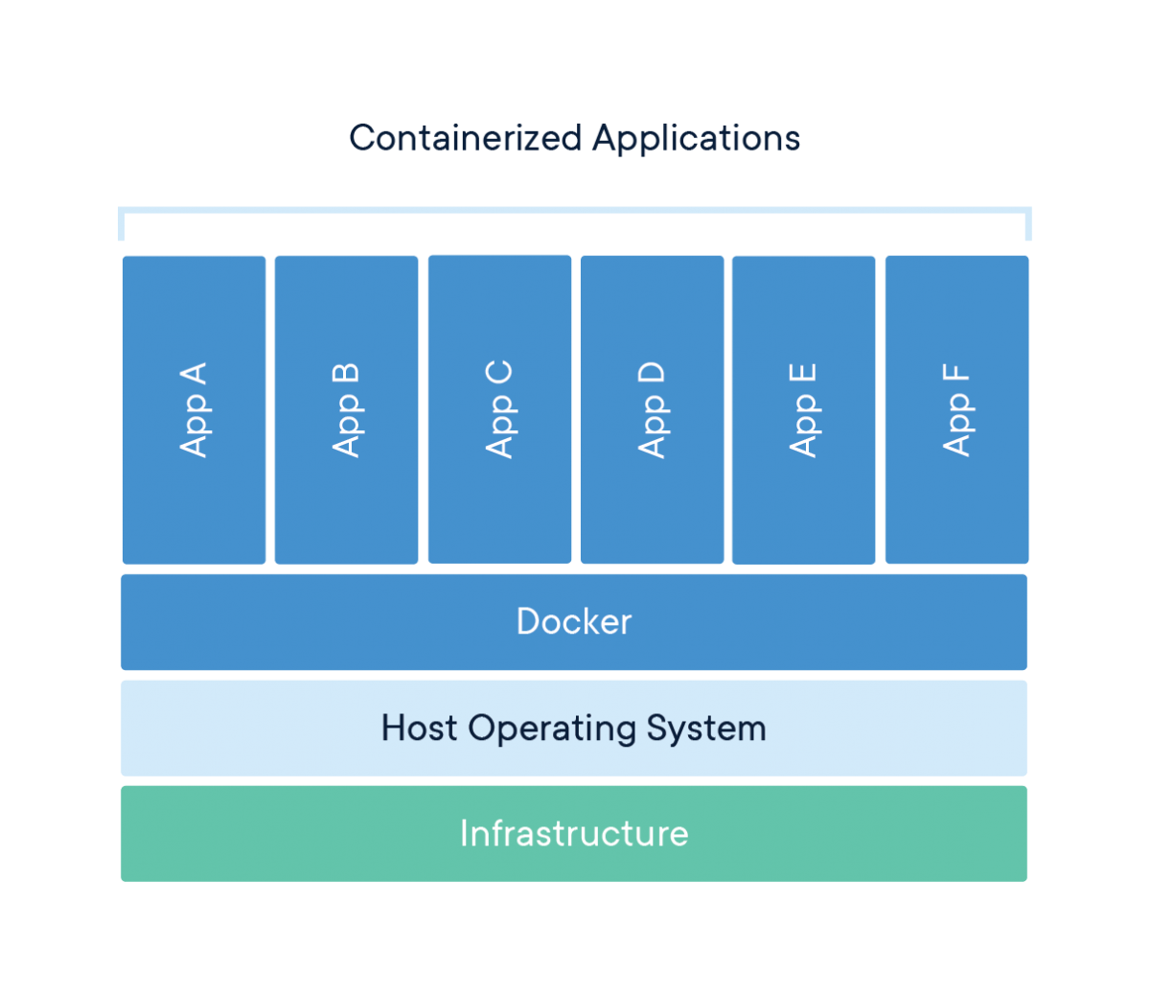
2- Dockerizing the Honeypot written in Python
What is Docker and why are we using it?
Docker is an engine for running Docker containers.
What does “Dockerization” mean?
Dockerizing Python honeypot (or almost any other Python application)
Docker Overview

Slide 20
2- Dockerizing the Honeypot written in Python
What is Docker and why are we using it?
Docker is an engine for running Docker containers.
Docker makes it super easy to deploy applications.
What does “Dockerization” mean?
Dockerizing Python honeypot (or almost any other Python application)
Docker Overview

Slide 21
2- Dockerizing the Honeypot written in Python
What is Docker and why are we using it?
Docker is an engine for running Docker containers.
Docker makes it super easy to deploy applications.
Other use cases: reproducibility, isolation, security, etc.
What does “Dockerization” mean?
Dockerizing Python honeypot (or almost any other Python application)
Docker Overview

Slide 22
2- Dockerizing the Honeypot written in Python
What is Docker and why are we using it?
Docker is an engine for running Docker containers.
Docker makes it super easy to deploy applications.
Other use cases: reproducibility, isolation, security, etc.
What does “Dockerization” mean?
Packing an application to run in Docker container.
Dockerizing Python honeypot (or almost any other Python application)
Docker Overview

Slide 23
2- Dockerizing the Honeypot written in Python
What is Docker and why are we using it?
Docker is an engine for running Docker containers.
Docker makes it super easy to deploy applications.
Other use cases: reproducibility, isolation, security, etc.
What does “Dockerization” mean?
Packing an application to run in Docker container.
Dockerizing Python honeypot (or almost any other Python application)
Docker Overview

Slide 24
2.3- Dockerizing Python honeypot
The “Normal” Way to Run App
git clone https://github.com/ResearcherOne/iot-honeypot.git
cd src

Slide 25
2.3- Dockerizing Python honeypot
The “Normal” Way to Run App
git clone https://github.com/ResearcherOne/iot-honeypot.git
cd src
sudo apt install python3-pip -y
sudo pip3 install virtualenv
virtualenv -p python3 venv
source venv/bin/activate

Slide 26
2.3- Dockerizing Python honeypot
The “Normal” Way to Run App
git clone https://github.com/ResearcherOne/iot-honeypot.git
cd src
sudo apt install python3-pip -y
sudo pip3 install virtualenv
virtualenv -p python3 venv
source venv/bin/activate
pip3 install sendgrid

Slide 27
2.3- Dockerizing Python honeypot
The “Normal” Way to Run App
git clone https://github.com/ResearcherOne/iot-honeypot.git
cd src
sudo apt install python3-pip -y
sudo pip3 install virtualenv
virtualenv -p python3 venv
source venv/bin/activate
pip3 install sendgrid
export SENDGRID_API_KEY="your-top-secret-sendgrid-api-key" && ...

Slide 28
2.3- Dockerizing Python honeypot
The “Normal” Way to Run App
git clone https://github.com/ResearcherOne/iot-honeypot.git
cd src
sudo apt install python3-pip -y
sudo pip3 install virtualenv
virtualenv -p python3 venv
source venv/bin/activate
pip3 install sendgrid
export SENDGRID_API_KEY="your-top-secret-sendgrid-api-key" && ...
sudo -E python3 ftp-honeypot.py

Slide 29
2.3- Dockerizing Python honeypot
The “Normal” Way to Run App
git clone https://github.com/ResearcherOne/iot-honeypot.git
cd src
sudo apt install python3-pip -y
sudo pip3 install virtualenv
virtualenv -p python3 venv
source venv/bin/activate
pip3 install sendgrid
export SENDGRID_API_KEY="your-top-secret-sendgrid-api-key" && ...
sudo -E python3 ftp-honeypot.py
Dockerizing This App
git clone https://github.com/ResearcherOne/iot-honeypot.git
cd src

Slide 30
2.3- Dockerizing Python honeypot
The “Normal” Way to Run App
git clone https://github.com/ResearcherOne/iot-honeypot.git
cd src
sudo apt install python3-pip -y
sudo pip3 install virtualenv
virtualenv -p python3 venv
source venv/bin/activate
pip3 install sendgrid
export SENDGRID_API_KEY="your-top-secret-sendgrid-api-key" && ...
sudo -E python3 ftp-honeypot.py
Dockerizing This App
git clone https://github.com/ResearcherOne/iot-honeypot.git
cd src
touch Dockerfile && nano Dockerfile

Slide 31
2.3- Dockerizing Python honeypot
The “Normal” Way to Run App
git clone https://github.com/ResearcherOne/iot-honeypot.git
cd src
sudo apt install python3-pip -y
sudo pip3 install virtualenv
virtualenv -p python3 venv
source venv/bin/activate
pip3 install sendgrid
export SENDGRID_API_KEY="your-top-secret-sendgrid-api-key" && ...
sudo -E python3 ftp-honeypot.py
Dockerizing This App
git clone https://github.com/ResearcherOne/iot-honeypot.git
cd src
touch Dockerfile && nano Dockerfile
FROM python:3
ADD ftp-honeypot.py /
RUN pip install sendgrid
CMD ["python", "./ftp-honeypot.py"]

Slide 32
2.3- Dockerizing Python honeypot
The “Normal” Way to Run App
git clone https://github.com/ResearcherOne/iot-honeypot.git
cd src
sudo apt install python3-pip -y
sudo pip3 install virtualenv
virtualenv -p python3 venv
source venv/bin/activate
pip3 install sendgrid
export SENDGRID_API_KEY="your-top-secret-sendgrid-api-key" && ...
sudo -E python3 ftp-honeypot.py
Dockerizing This App
git clone https://github.com/ResearcherOne/iot-honeypot.git
cd src
touch Dockerfile && nano Dockerfile
FROM python:3
ADD ftp-honeypot.py /
RUN pip install sendgrid
CMD ["python", "./ftp-honeypot.py"]
sudo docker build -t ftp-honeypot .

Slide 33
2.3- Dockerizing Python honeypot
The “Normal” Way to Run App
git clone https://github.com/ResearcherOne/iot-honeypot.git
cd src
sudo apt install python3-pip -y
sudo pip3 install virtualenv
virtualenv -p python3 venv
source venv/bin/activate
pip3 install sendgrid
export SENDGRID_API_KEY="your-top-secret-sendgrid-api-key" && ...
sudo -E python3 ftp-honeypot.py
Dockerizing This App
git clone https://github.com/ResearcherOne/iot-honeypot.git
cd src
touch Dockerfile && nano Dockerfile
FROM python:3
ADD ftp-honeypot.py /
RUN pip install sendgrid
CMD ["python", "./ftp-honeypot.py"]
sudo docker build -t ftp-honeypot .
sudo docker run -p 21:21 -e "SENDGRID_API_KEY=your-top-secret-sendgrid-api-key" -e "more_env_variables_here" ftp-honeypot

Slide 34
3- Deployment of Dockerized Honeypot on a Raspberry Pi
What is Raspberry Pi and Docker Pirates?
How to install Docker Pirates on a Raspberry Pi?
How to deploy Dockerized Python Honeypot on Raspberry Pi?

Slide 35
3- Deployment of Dockerized Honeypot on a Raspberry Pi
What is Raspberry Pi and Docker Pirates?
Raspberry Pi is 35$ credit-card sized computer.
How to install Docker Pirates on a Raspberry Pi?
How to deploy Dockerized Python Honeypot on Raspberry Pi?

Slide 36
3- Deployment of Dockerized Honeypot on a Raspberry Pi
What is Raspberry Pi and Docker Pirates?
Raspberry Pi is 35$ credit-card sized computer.
Docker Pirates is Docker-ready OS image for Pi.
How to install Docker Pirates on a Raspberry Pi?
How to deploy Dockerized Python Honeypot on Raspberry Pi?

Slide 37
3- Deployment of Dockerized Honeypot on a Raspberry Pi
What is Raspberry Pi and Docker Pirates?
Raspberry Pi is 35$ credit-card sized computer.
Docker Pirates is Docker-ready OS image for Pi.
How to install Docker Pirates on a Raspberry Pi?
How to deploy Dockerized Python Honeypot on Raspberry Pi?

Slide 38
3.2- How to install Docker Pirates on a Raspberry Pi?
Source: https://blog.hypriot.com/post/releasing-HypriotOS-1-11/

Slide 39
3.2- How to install Docker Pirates on a Raspberry Pi?
Source: https://blog.hypriot.com/post/releasing-HypriotOS-1-11/
curl -O https://raw.githubusercontent.com/hypriot/flash/2.3.0/flash
chmod +x flash
sudo mv flash /usr/local/bin/flash

Slide 40
3.2- How to install Docker Pirates on a Raspberry Pi?
Source: https://blog.hypriot.com/post/releasing-HypriotOS-1-11/
curl -O https://raw.githubusercontent.com/hypriot/flash/2.3.0/flash
chmod +x flash
sudo mv flash /usr/local/bin/flash
wget https://github.com/hypriot/image-builder-rpi/releases/download/v1.11.0/hypriotos-rpi-v1.11.0.img.zip

Slide 41
3.2- How to install Docker Pirates on a Raspberry Pi?
Source: https://blog.hypriot.com/post/releasing-HypriotOS-1-11/
curl -O https://raw.githubusercontent.com/hypriot/flash/2.3.0/flash
chmod +x flash
sudo mv flash /usr/local/bin/flash
wget https://github.com/hypriot/image-builder-rpi/releases/download/v1.11.0/hypriotos-rpi-v1.11.0.img.zip
flash -u wifi.yml ./hypriotos-rpi-v1.11.0.img.zip

Slide 42
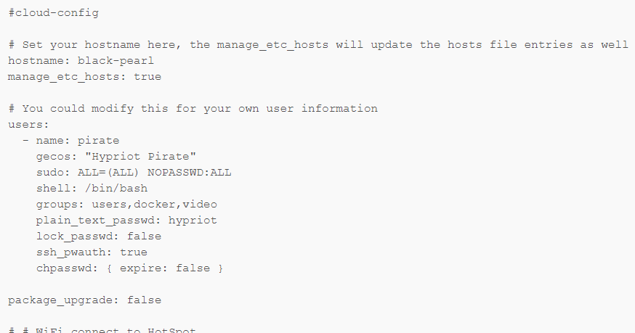
3.2- How to install Docker Pirates on a Raspberry Pi?
wifi.yml

Slide 43
3.2- How to install Docker Pirates on a Raspberry Pi?
ssh pirate@black-pearl.local
date -s '2014-12-25 12:34:56' && echo “The date should be current time”

Slide 44
3.2- How to install Docker Pirates on a Raspberry Pi?
ssh pirate@black-pearl.local
date -s '2014-12-25 12:34:56' && echo “The date should be current time”
git clone https://github.com/ResearcherOne/iot-honeypot.git
cd src

Slide 45
3.2- How to install Docker Pirates on a Raspberry Pi?
ssh pirate@black-pearl.local
date -s '2014-12-25 12:34:56' && echo “The date should be current time”
git clone https://github.com/ResearcherOne/iot-honeypot.git
cd src
sudo docker build -t ftp-honeypot .
sudo docker run -p 21:21 -e "SENDGRID_API_KEY=your-top-secret-sendgrid-api-key" -e "more_env_variables_here" ftp-honeypot

Slide 46
4- Honeypot in Action!
The scenario:
Attacker compromised wireless home network.

Slide 47
4- Honeypot in Action!
The scenario:
Attacker compromised wireless home network.
Performing network scanning to figure out devices and services.

Slide 48
4- Honeypot in Action!
The scenario:
Attacker compromised wireless home network.
Performing network scanning to figure out devices and services.
Realize that an ftp service is running on a host.

Slide 49
4- Honeypot in Action!
The scenario:
Attacker compromised wireless home network.
Performing network scanning to figure out devices and services.
Realize that an ftp service is running on a host.
Login to ftp and exploit the machine (through brute-force etc.)

Slide 50
4- Honeypot in Action!
Attacker figures out his/her ip address in home network.
ifconfig

Slide 51
4- Honeypot in Action!
Attacker figures out his/her ip address in home network.
ifconfig

Slide 52
4- Honeypot in Action!
Performing network scanning
nmap 192.168.1.0/24

Slide 53
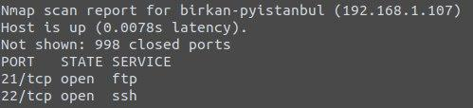
4- Honeypot in Action!
Performing network scanning
nmap 192.168.1.0/24

Slide 54
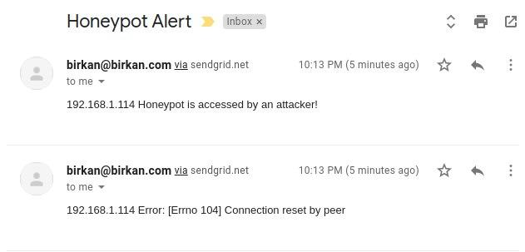
4- Honeypot in Action!
This action triggered alert on the honeypot:

Slide 55
4- Honeypot in Action!
Attacker connects to ftp service on target machine.
ftp 192.168.1.107

Slide 56
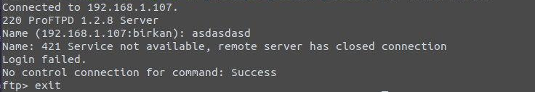
4- Honeypot in Action!
Attacker connects to ftp service on target machine.
ftp 192.168.1.107

Slide 57
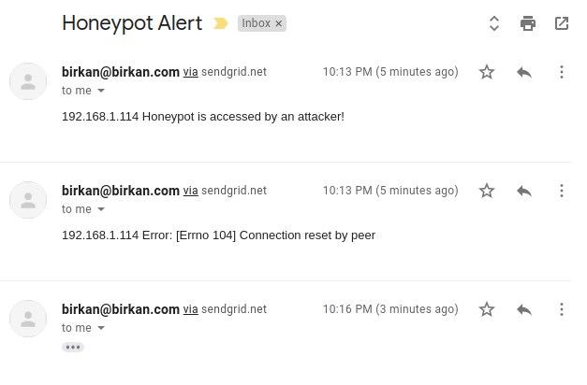
4- Honeypot in Action!
This action also triggered alert on the honeypot:

Slide 58
References
https://searchsecurity.techtarget.com/definition/honey-pot
https://en.wikipedia.org/wiki/The_Cuckoo%27s_Egg
sshesame - https://github.com/jaksi/sshesame
Mert Sarıca “Tuzak Sistem ile Hacker Avı” - https://www.mertsarica.com/tuzak-sistem-ile-hacker-avi/
https://www.docker.com/resources/what-container
https://www.linode.com/docs/applications/containers/when-and-why-to-use-docker/

